Slide 1
Eco-Lyf
Team Triple-E

Slide 2



Table of contents
Problem Statement
Solution/Demo
Future Development
Research and Insights

Slide 3
Challenge Statement
How can we enhance the sustainability and environmental impact of Lyf communities

Slide 4
Problem Statement
Lyf
Carbon Issue
Under Utilisation of the Kitchen
Food Delivery causes High Carbon Emission

Slide 5

Sustainability in Food Delivery
Transport
Packaging
Ingredients
Average food delivery emits approximately 6.3 kg of CO₂ per order
Around 60-70% of food delivery orders use non-recyclable packaging
17% of products are marketed as sustainable
https://www.carbonbrief.org/food-miles-have-larger-climate-impact-than-thought-study-suggests/
https://trec.pdx.edu/research/project/154/Food_Delivery_Footprint:_Addressing_Transportation,_Packaging,_and_Waste_in_the_Food_Supply_Chain
https://www.bcg.com/publications/2023/whetting-consumers-appetite-for-sustainable-foods
Notes:
Contributing significantly to urban carbon emissions.
This waste contributes to pollution impacting local ecosystems

Slide 6
USD 112.67 billion
19.7%
USD 449.67 billion
Market Size in 2023
Compound Annual Growth Rate
Forecast by 2030
https://www.futuredatastats.com/sustainable-food-delivery-services-market

Slide 7
Our Solution
01
02
03
04
Lyf Mart
Lyf Kitchen
Booking
Rewards
Offers resident convenient access to sustainable ingredients in measurable quantity
Self Cook/Chef Cook creating a unique, customizable dining experience
Maximizes kitchen resource usage, increasing occupancy rates and revenue potential
Incentivizes sustainability, building engagement with a point system

Slide 8
Demo

Slide 9
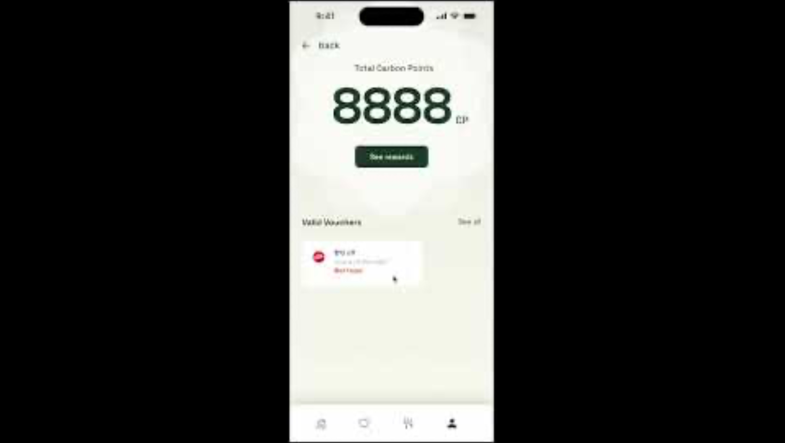

Slide 10
Future Development
BBQ Pit
Partner Discount
Reusable Concept
Collaboration with local eco-friendly brands
Events
Community Engagement

Slide 11
Thanks!
Do you have any questions?

